Slide 1
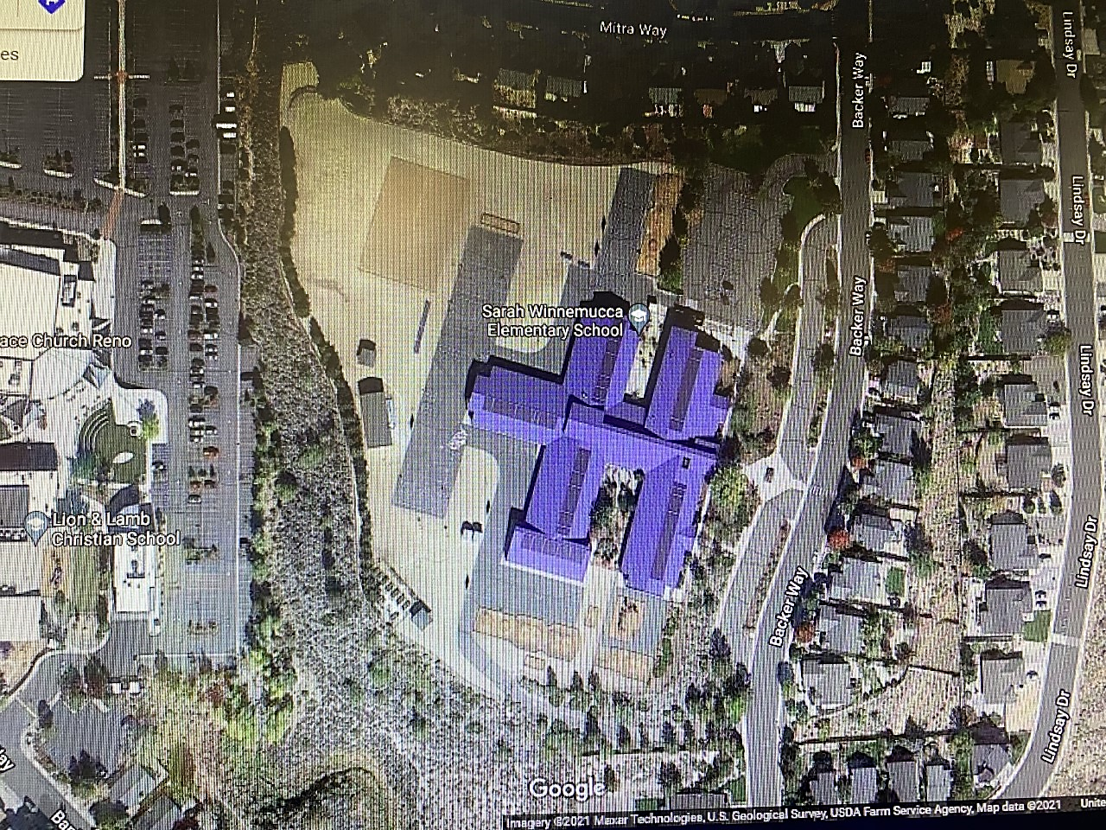
Enter down Backer Way SCHOOL ZONE 15 MPH
3rd, 4th and 5th grade gate
Drop off in the drive way. Students walk to gates
Exit: Left turn only. Exit out Backer Way SCHOOL ZONE 15 MPH
K, 1st, 2nd grade gate

